Slide 1
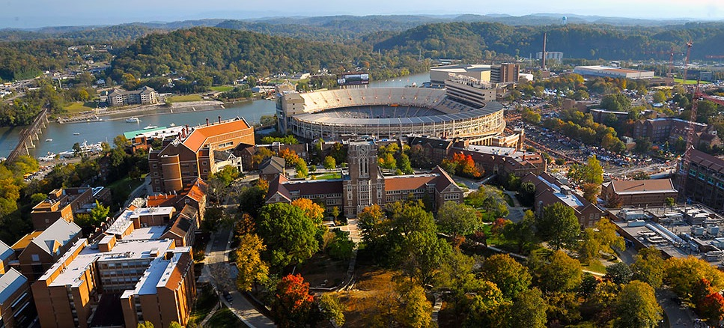
PREPARING A SUCCESFUL P&T DOSSIER
Emma Willcox
Associate Professor in Wildlife Science
60% Teaching, 40% Research
Department of Forestry, Wildlife and Fisheries

Slide 2
START EARLY
Understand:
Appointment
- Expectations
Review:
Manual for Faculty Evaluation
Faculty Handbook
Successful dossiers
UTIA AgResearch Report on Research Excellence
Prepare:
Start filling in dossier template
- Make additions monthly
- Treat each annual review as the real thing
Feedback:
Seek input
- Mentors, colleagues, recently tenured

Slide 3
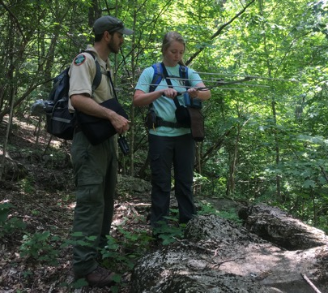
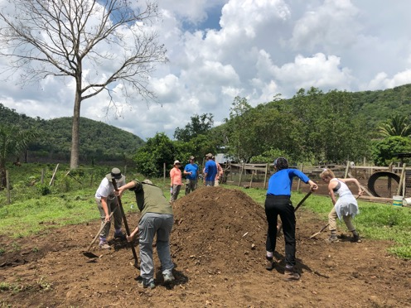
BUILD STRONG RELATIONSHIPS

Slide 4
SHOW CONNECTIONS
Integrated
Teaching Research Service
MY PROGRAM
MY STORY

Slide 5
TEACHING
Teaching and Learning Innovation:
Workshops
Summer Institutes
Grants and awards

Slide 6
TEACHING
Evaluations:
Students
Use Campus Labs system
Include quotes
- Consider developing your own
Faculty
As many as possible
Beyond basic form
Detail Improvements

Slide 7
TEACHING
Extra Contributions:
Guest Lectures
Freshman Seminars
Other Relevant Activities
Service learning
Undergraduate research
Study abroad
Teaching Grants, Awards, and Publications
List separate from research
Undergraduate and Graduate Research
Highlight their achievements

Slide 8
RESEARCH
Strong Relationships:
Understand research needs
Collaborations
Co-authorship
AGAIN!!!
Understand Expectations:
UTIA AgResearch Report
Mentor
Other faculty members
Graduate Students:
Publications
Presentations
Awards

Slide 9
SERVICE
Be Strategic:
Institutional
Professional
Public
RECOGNIZE CANNOT DO IT ALL!

Slide 10
GENERAL STRATEGY
Help Reader:
Clear concise format
Highlight achievements
Summarize each section
Use Your Mentors:
Content
Editorial

Slide 11
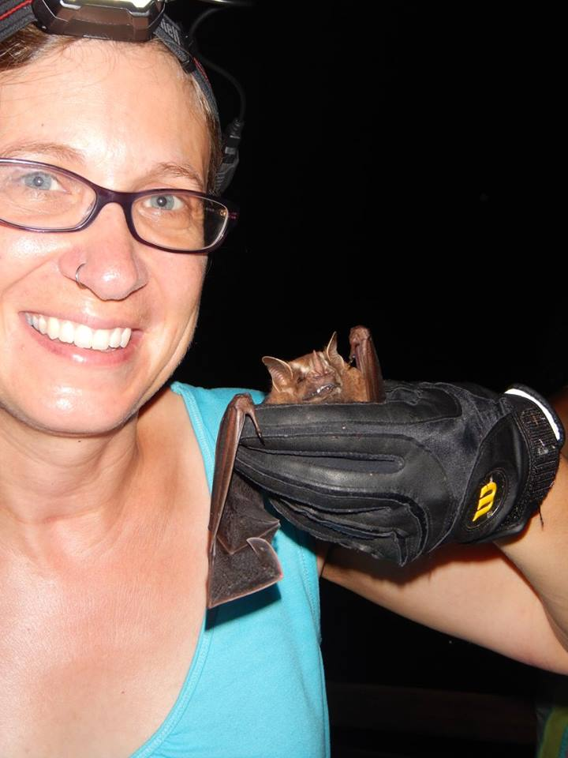
QUESTIONS?
Emma Willcox
Associate Professor in Wildlife Science
Department Forestry, Wildlife and Fisheries
ewillcox@utk.edu
Acknowledgements: David Buehler, John Zobel, Keith Belli, TWRA, NPS, USFWS

