Slide 1
UTIA P&T Workshop
Overview of P&T Process
April 29, 2019

Slide 2
Overview of P&T Process
Assistant to Tenured Associate Professor
Associate to Full Professor

Slide 3
Overview of P&T Process
Assistant to Tenured Associate Professor
Hired
Annual Review Reports/Retention
Mid-Cycle Review
Annual Review Reports/Retention
Promotion and Tenure Review

Slide 4
Overview of P&T Process
Associate to Full Professor
Annual Review Reports
Promotion Review Dossier (only since promotion)
Associate/Full Professor … 6-year Reviews
Process Being Implemented in 2019

Slide 5
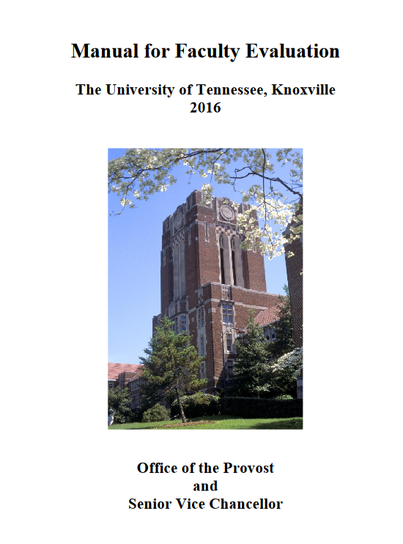
Overview of P&T Process
Dossier
See Manual for Faculty Evaluation (2016)
(http://provost.utk.edu)
Follow Outline in Appendix B
Sections A – E (faculty)
Sections F and G (Dept. Head)

Slide 6
Overview of P&T Process The Dossier
Summary Sheet: Recommendations for P&T (DH)
Educational History and Employment History (Example Provided)
Statement of Responsibilities (DH)
Department and College Criteria Statements (Standard)
Certification of Competence to Communicate in English (Form)
B. Teaching Ability and Effectiveness (Candidate)
C. Research, Scholarship, Creative Achievement (Candidate)
D. Institutional, Disciplinary, and/or Professional Service (Candidate)
Candidate Signature Statement (Candidate)
External Letters of Assessment (DH)
Evaluative Recommendations, Reports, and Statements (DH)

Slide 7
B. Teaching Ability and Effectiveness
Section 1 Must Include:
Teaching philosophy
List of courses taught
Student evaluation compilation or documented evaluation of candidate’s programs
Peer teaching evaluation
May provide summary of student comments (DH)
Section 2 May Include:
Administrators’ statements
Teaching/Advising effectiveness
Teaching honors/awards
Supervised graduate dissertations
Undergraduate honor theses supervised
Memberships on graduate degree candidates’ committees
Expertise/Experience in international/intercultural activities

Slide 8
C. Research, Scholarship, Creative Activity
Candidate’s Statement
Research and/or Scholarly Publications
Creative Activity
Projects, Grants, Commissions, and Contracts
Other Evidence of Research or Creative Accomplishments (patents, new software programs developed, etc.)
Seminars and Workshops
Papers Presented at Technical/Professional Meetings
Honors/Awards
Grants/Contracts for Instruction/Training Programs

Slide 9
D: Institutional, Disciplinary, and/or Professional Service
Candidate’s Statement
Institutional Summary
Committee work
University-wide governance bodies
Contributions to enhance equal opportunity, cultural diversity, and international and intercultural awareness
Disciplinary Service
Offices held, committee work, journal refereeing in professional societies
Academic discipline service honors/awards
Professional Service
Public/private organizations
Governmental agencies
Industry
Community affairs

Slide 10
Overview of P&T Process
Steps in the process …
Summer before
Finalize dossier and CV - work with mentor(s)
Submit list of potential external reviewers
Submit final dossier and supporting materials to department head (Oct 19)
Departmental review (Oct 19 – Dec 14)
Department head review (Dec 17)

Slide 11
Overview of P&T Process
Steps in the process …
Dissenting statements, candidate/faculty (Jan 2)
P&T Committee recommendations to the Dean(s) (Feb 1)
Dissenting statements (Feb 15)
Dean(s) recommendations to the Chancellor (March 1)
Dissenting statements (March 15)

Slide 12
Overview of P&T Process
Steps in the process …
Chancellor to forward P&T recommendations to UT President (May 3)
Dissenting statements (May 17)
Final decision from Board of trustees (June meeting)

