Slide 1
The Scholarship of Teaching and Learning UTIA Promotion and Tenure Workshop May 4, 2023 David G. White Interim Dean

Slide 2
Criteria for Appointment to Faculty Rank
Demonstrated record of achievement and the promise of continued excellence
Reflected in the faculty member’s –
teaching (which includes advising and mentoring)
research
service or other creative work in the discipline
participation in professional organizations
willingness to contribute to the common life of the university
effective work with colleagues and students, including the faculty member’s ability to interact appropriately with colleagues and students

Slide 3
Rank: Expanding Expectations
Assistant professors are expected to
1. hold the doctorate or other terminal degree of the discipline, or to present equivalent training
and experience as appropriate to the particular appointment
2. show promise as teachers
3. show promise of developing a program in disciplinary research / scholarship / creative
activity that is gaining external recognition
Associate professors are expected to
1. hold the doctorate or other terminal degree of the discipline, or to present equivalent training
and experience as appropriate to the particular appointment
2. be good teachers
3. have achieved and to maintain a recognized record in disciplinary research / scholarship /
creative activity
Professors are expected to
1. hold the doctorate or other terminal degree of the discipline, or to present equivalent training
and experience as appropriate to the particular appointment
2. be accomplished teachers
3. have achieved and to maintain a nationally recognized record in, disciplinary research /
scholarship / creative activity

Slide 4
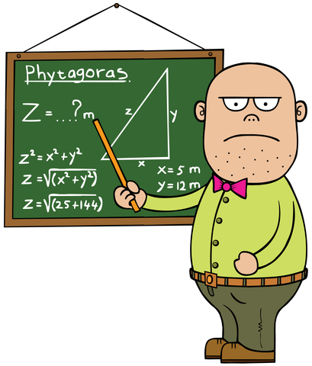
What is an adequate teacher?
Reliably goes to class on time and teaches
Predominately uses “sage on the stage” approach to teaching
Occasionally updates course content
Uses homework and test grades for feedback
Passes back graded material in a timely manner
Meets with advisees regularly

Slide 5
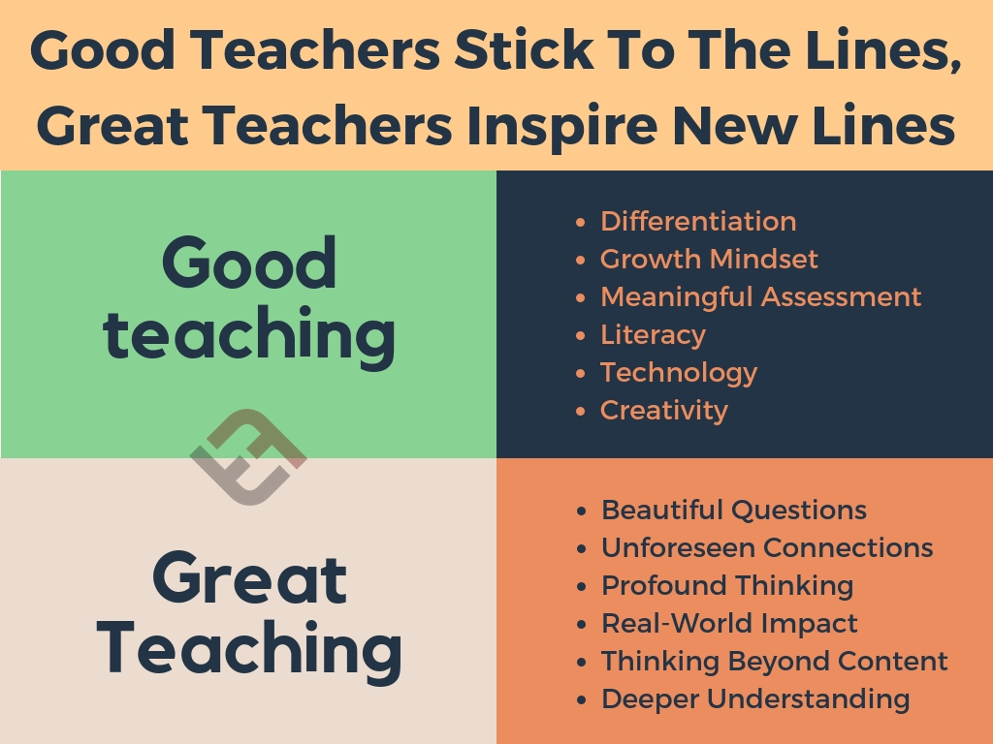
What is a good teacher?
Uses a variety of teaching styles and techniques
Realizes that learning occurs not only in the classroom but outside of it as well
Uses embedded classroom assessment techniques for continuous feedback on learning in addition to tests and grades
Advises the student with a goal of on-time graduation and ultimately professional placement and success in the workplace
Mentors graduate students
Attends teaching workshops and seminars

Slide 6
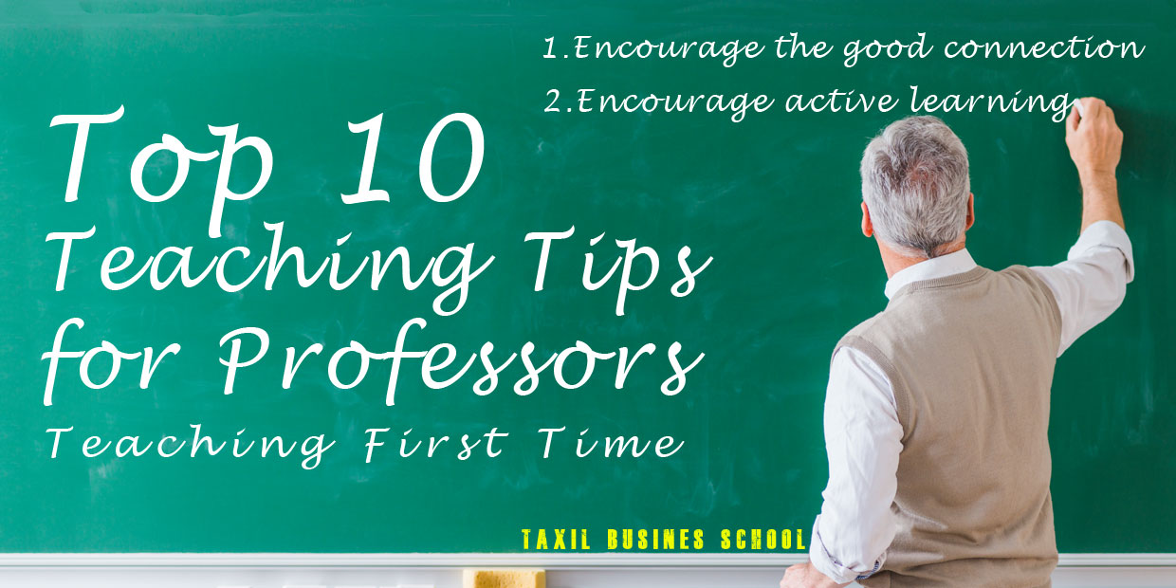
What is an “accomplished” teacher?
In the classroom:
Keeps students engaged using a variety of innovative approaches
Uses feedback in a formative manner to improve interactions and the course
Incorporates experiential and service learning where appropriate
Seeks rigor and challenges the student

Slide 7
What is an “accomplished” teacher?
Outside the classroom:
Advises undergraduates with emphasis on
Retention
Timely graduation
Placement
Helps students find internships and developmental opportunities
Helps to mentor student clubs and activities
Involved in recruiting (in particular with underrepresented groups)
Sponsors and directs undergraduate research and honors projects
Serves on or leads committees such as graduate and undergraduate coordinator, scholarship and recruitment committees
Mentors graduate students with the intent to publish and present their work

Slide 8
Open to continual improvement
Attends faculty development workshops
Invites observation and assessment of teaching effectiveness
Uses the resources of the UTK Teaching and Learning Innovation Center
Participates in and presents at national meetings on teaching
Writes peer-reviewed publications to share best practices in teaching
Receives awards from the department, college, university, professional society, and even national recognition (USDA Teaching Excellence)
Seeks funding from external sources to augment teaching or other aspects of the student life
USDA Workforce Preparation
HEC
University grants
An excellent teacher clearly demonstrates the SCHOLARSHIP of teaching!
What is an “accomplished” teacher?

Slide 9
How to Document Scholarship
Personal
External
Products
teaching philosophy
syllabi w/ course objectives
video of teaching
professional development
instructional innovations
reflection
personal goals
self-evaluation
classroom observation
external review of course materials
student evaluations
peer assessment
alumni/industry feedback
awards & honors
invited presentations
service/leadership
pre & post-test scores
graded work
projects
record of student successes
books, manuals, CDs
Publications
Grants
websites

Slide 10
Teaching Ability and Effectiveness
Faculty are expected to become good, solid teachers who work enthusiastically with students, try new approaches to pedagogy, and contribute to the development of departmental programs
Practice and promote effective and innovative teaching and student engagement approaches

Slide 11
Questions / Comments

